Slide 1


Football Player Value Estimate
Burak Arslan

Slide 2
Introduction
Predict Football Player Value by statistics.

Slide 3









Methodology
Data :
Top 5 League 2019/2020 Season Statistics ( https://fbref.com/en/ )
Sega Football Manager 2021 Game Player Values
Transfermarkt.de Player Values
1 - Web Scraping
2 - Exploratory Data Analysis
3 - Feature Modify
4 - Cross Validation
5 - Feature Modify
6 - Linear Regression

Slide 4
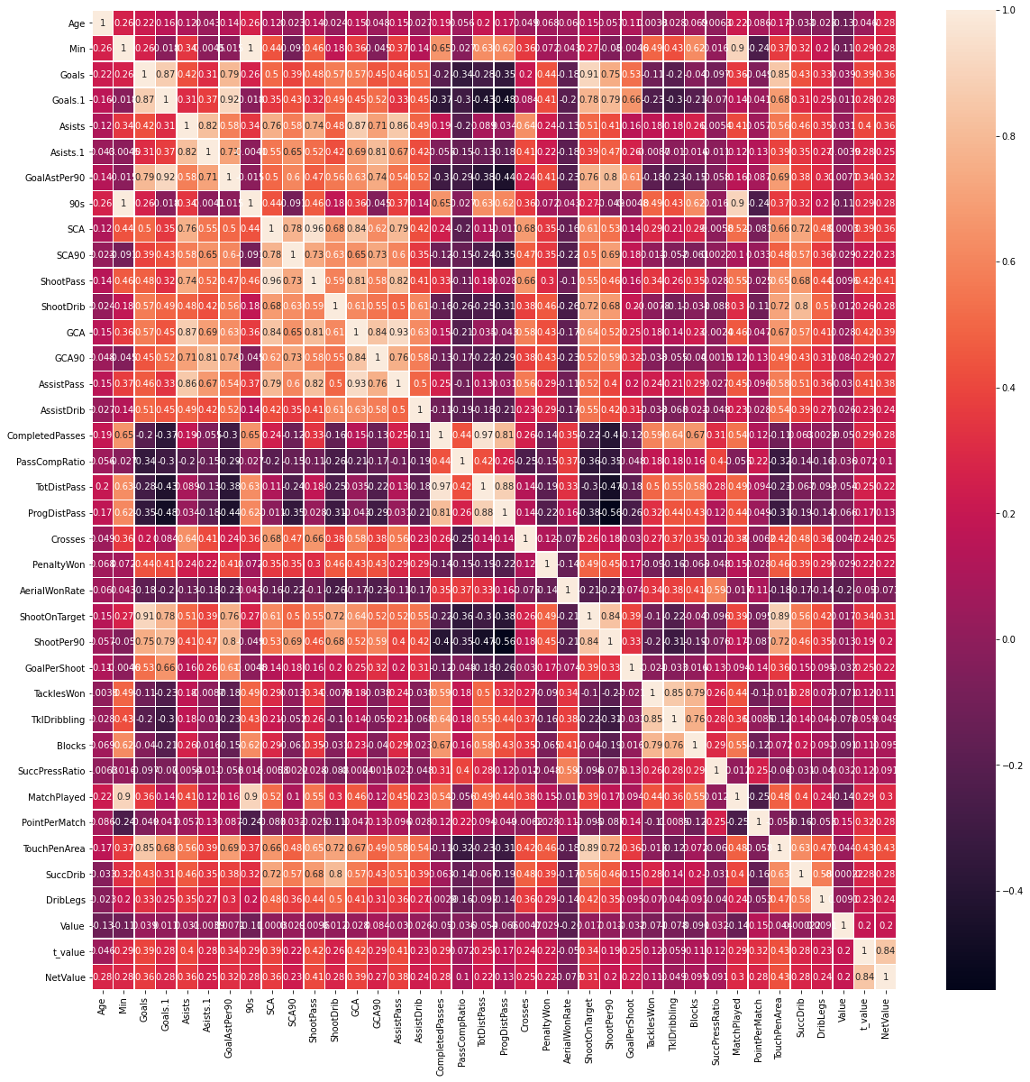
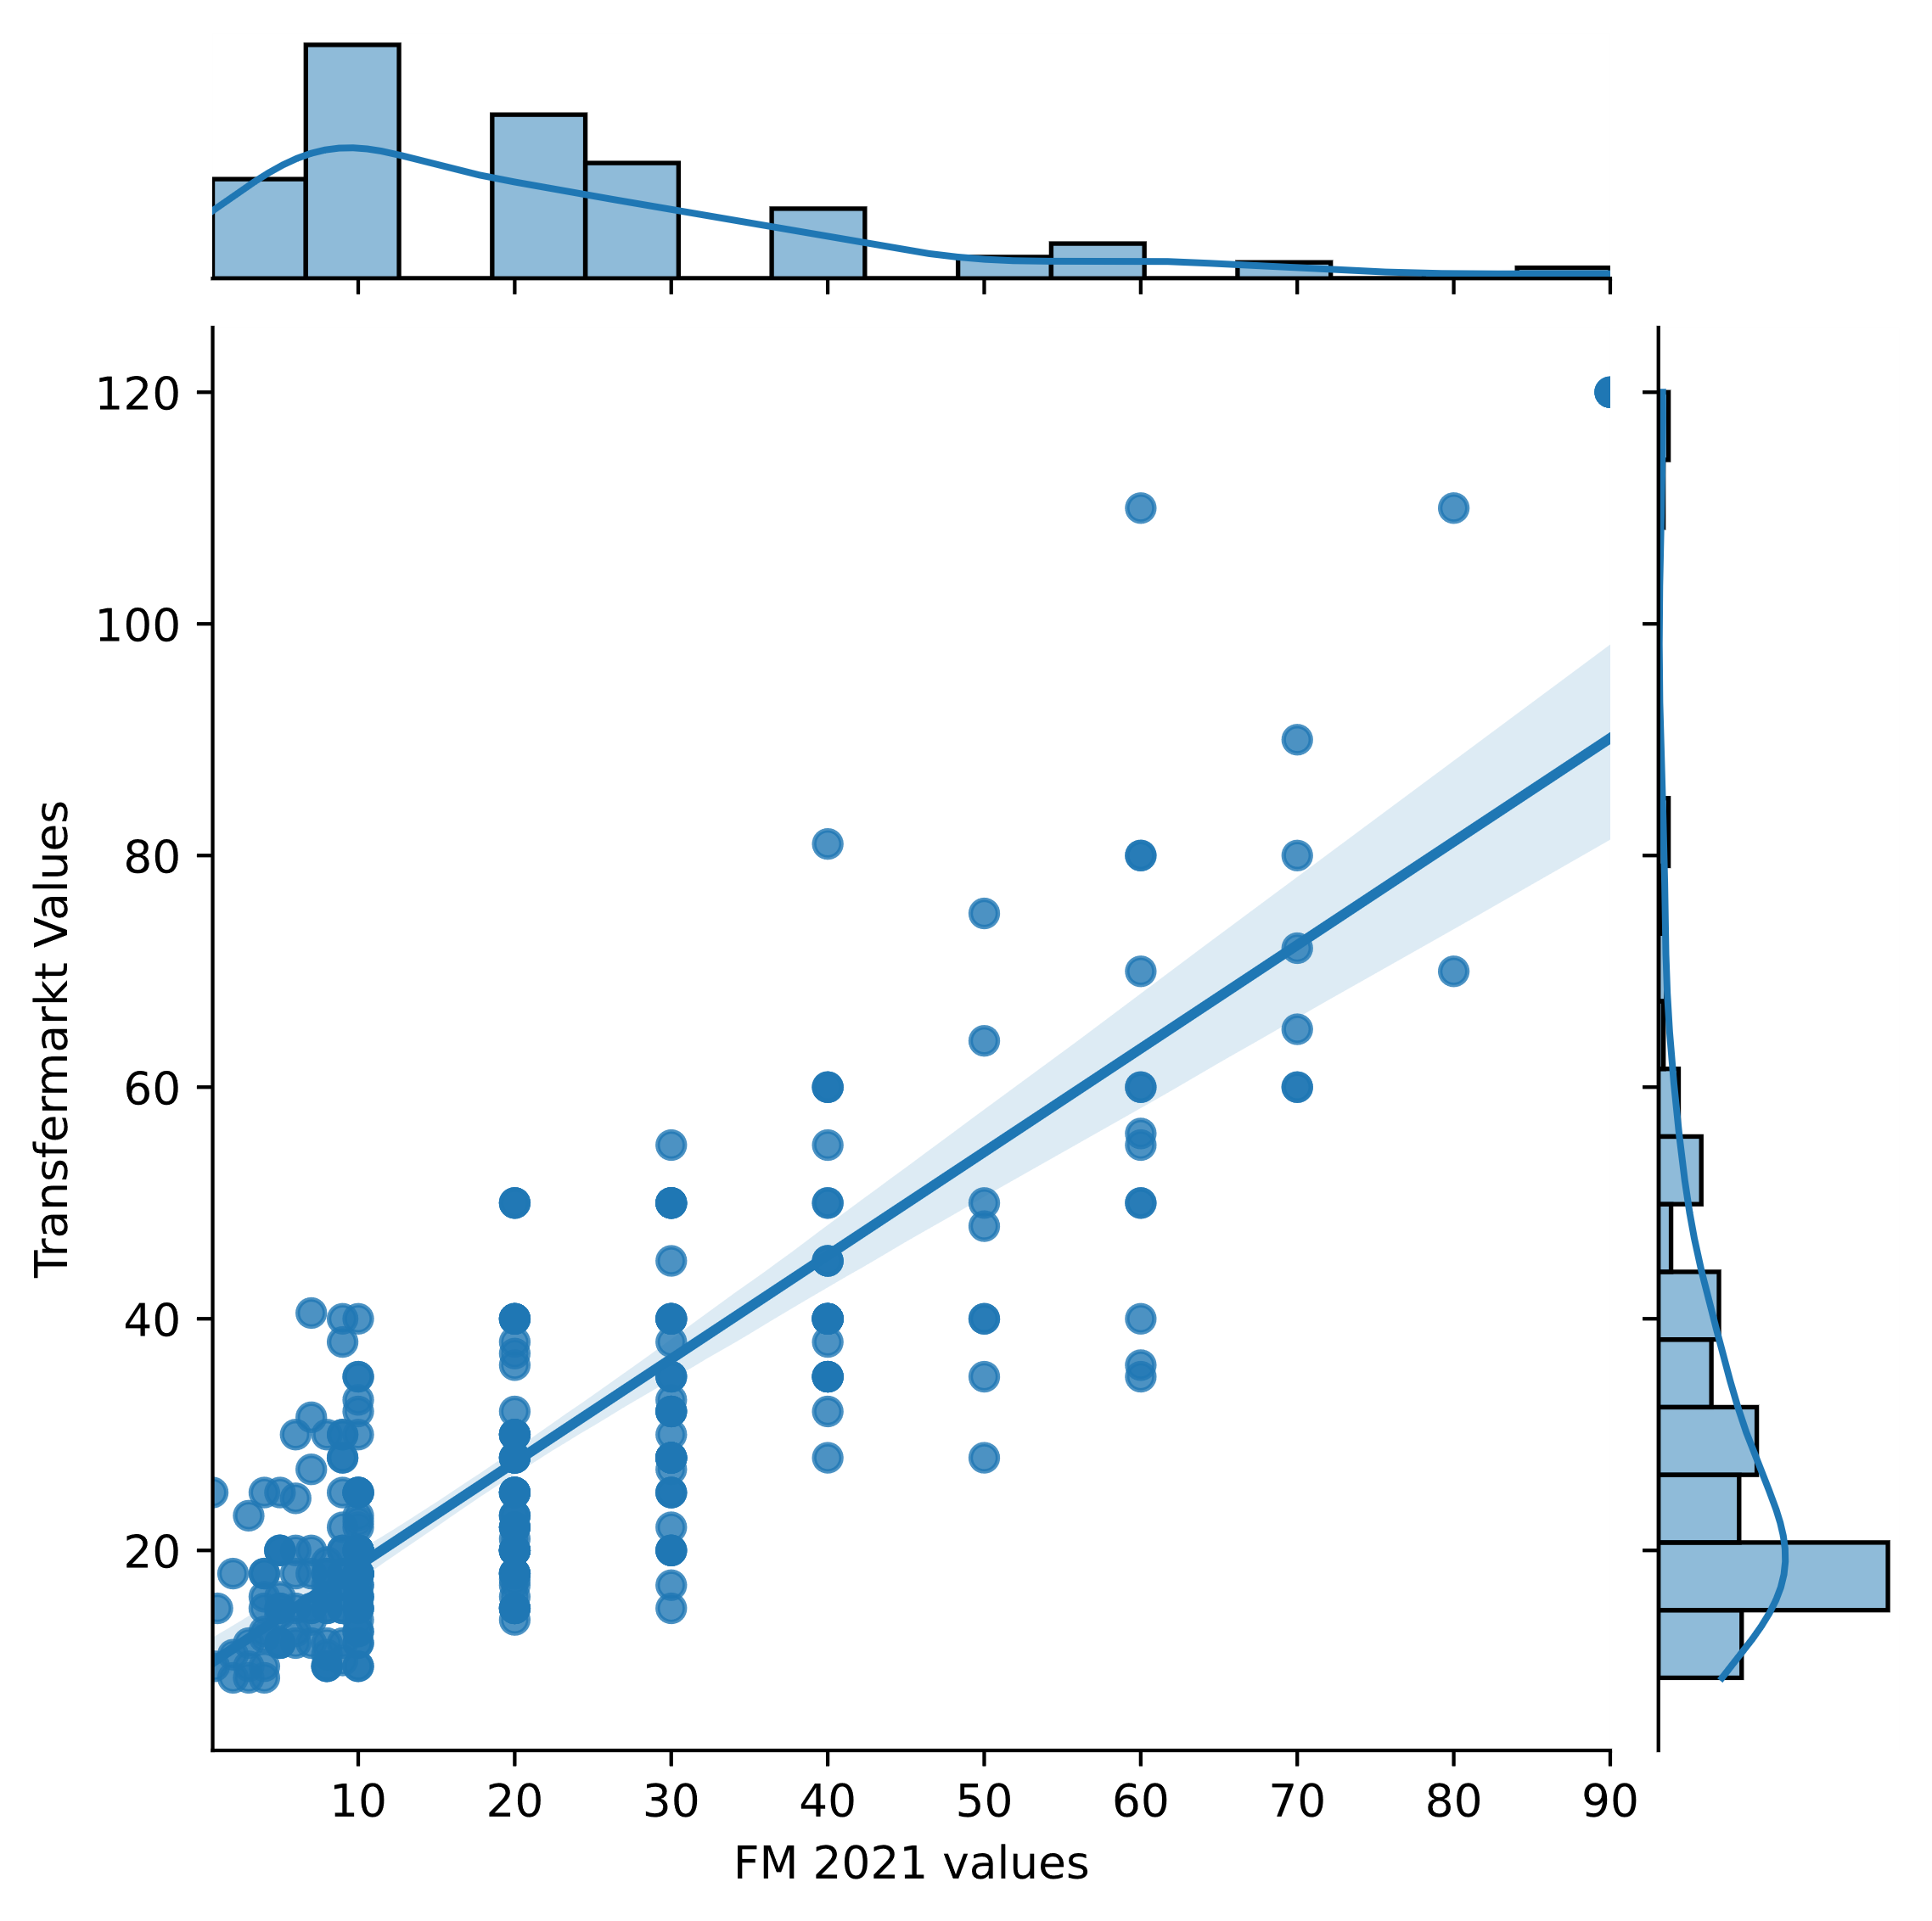
Methodology
Challenges:
48 features is too much to handle !
Predict the uncertain !
Features :
Position - Age - Minutes Played - League - Match Played - Point Per Match
Goals - Goals per Match - Assists - Assists per Match - Dribbling lead to Goal or Assist - Minutes Played as 90
Shoot Change Creation - Shoot Change Creation per Match - Shoot Pass - Shoot Dribbling - Goal Change Creation - Goal Change Creation per Match
Assist Pass - Assist Dribbling - Penalty Won - Dribbled Player Count
Shoot On Target - Shoot Per Match - Goal Per Shoot - Touch Ball in Penalty Area
Completed Passes - Pass Success Ratio - Total Distance Passes - Progressive Distance Passes - Crosses
Aerial Won Rate - Tackles Won - Tackles that end Dribbling - Blocks - Successful Pressing Ratio

Slide 5
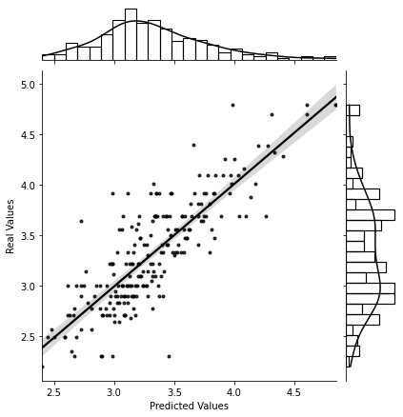
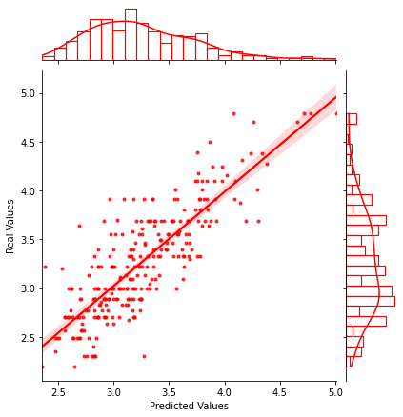
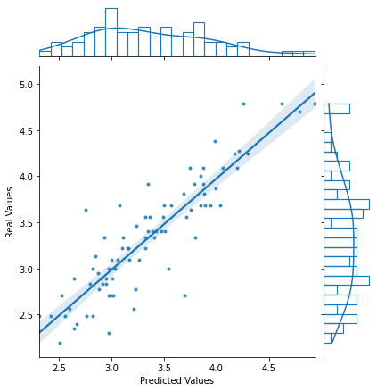
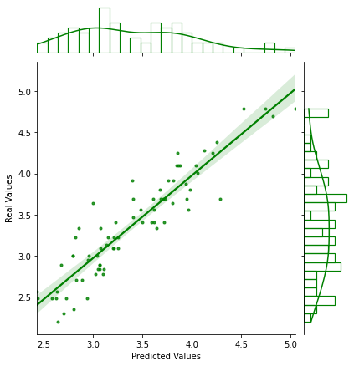
Results
All Players
Defenders
Midfielders
Forwards
R^2 score : 0.69
R^2 score : 0.68
R^2 score : 0.79
R^2 score : 0.86

Slide 6
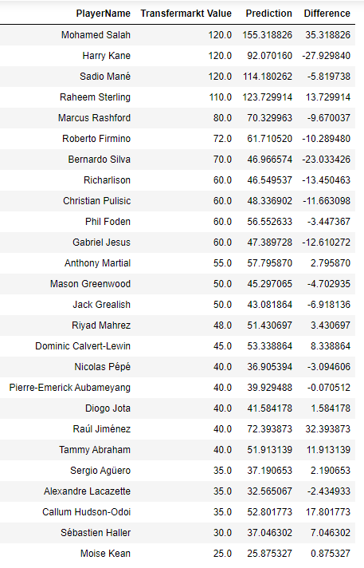
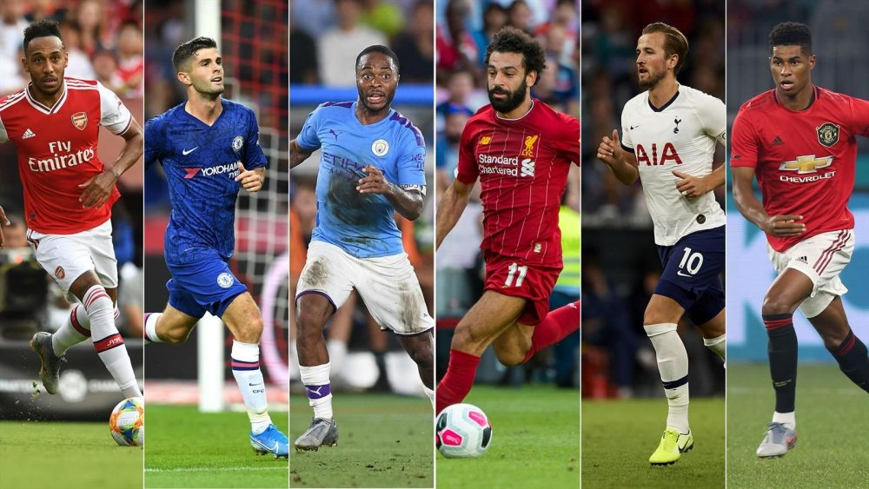
Results

Slide 7
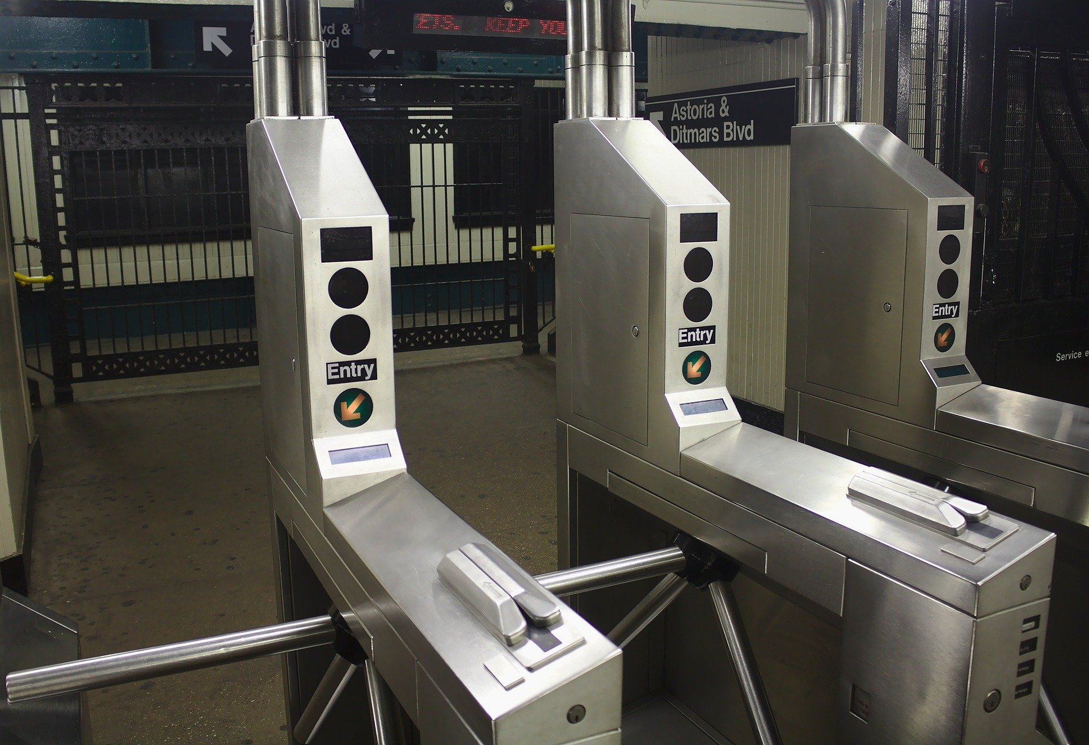
Conclusions
For more accuracy, models must build on each player type.

Slide 8
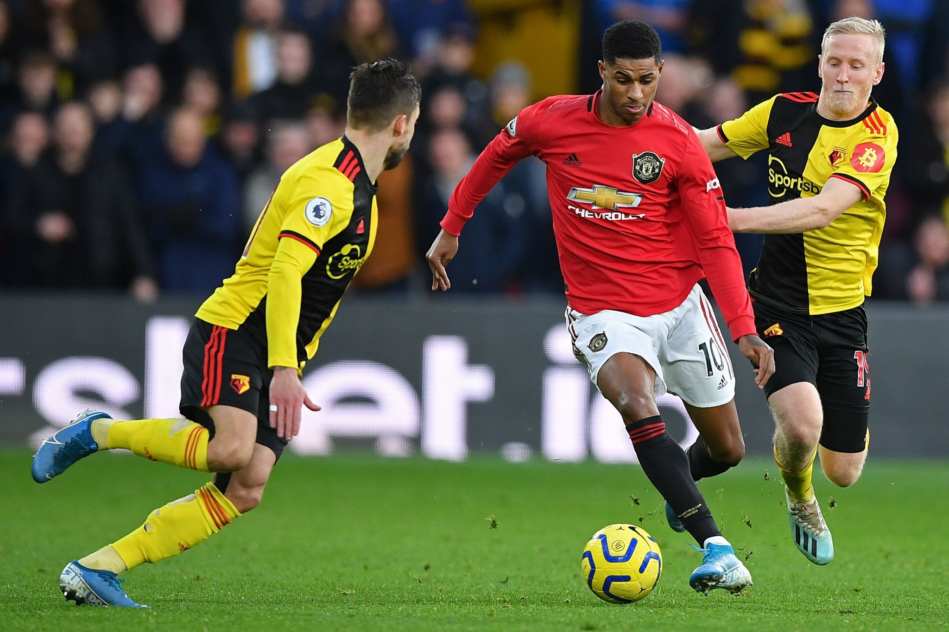
Future Work
Data Enrichment Options :
Substitute players.
Team members effect player statistics.
Prone to injury.
Last year on contract .
Player home country popularity.
Can play big matches !
Player leadership.
Work rate & ethics
Web search popularity

Slide 9
Appendix

Slide 10
Appendix

